Slide 1
Introduction of SVM^{struct}
Hung-yi Lee
Notes:
http://tfinley.net/software/svmpython2/multiclass_code.html
http://tfinley.net/software/svmpython2/
http://www.cs.cornell.edu/people/tj/svm_light/svm_multiclass.html

Slide 2
SVM^{struct}
API for implementing different kinds of structured learning tasks by structured SVM
C: https://www.cs.cornell.edu/people/tj/svm_light/svm_struct.html
Python: http://tfinley.net/software/svmpython2/
MATLAB: http://www.robots.ox.ac.uk/~vedaldi/svmstruct.html
Structured SVM with Hidden Information
http://www.cs.cornell.edu/~cnyu/latentssvm/

Slide 3
SVM^{struct}
Python version in these slides
Download from http://tfinley.net/software/svmpython2/svm-python-v204.tgz
To build this, a simple make should work.
svm_python_learn: for learning a model and
svm_python_classify: for testing with a learned model

Slide 4
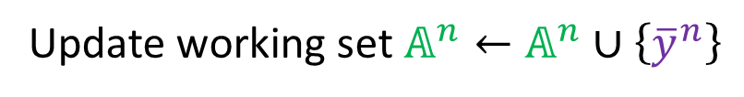
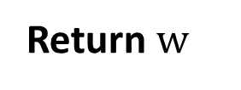


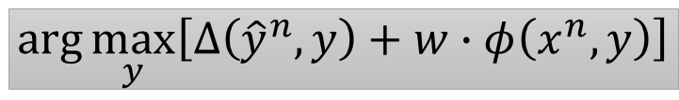
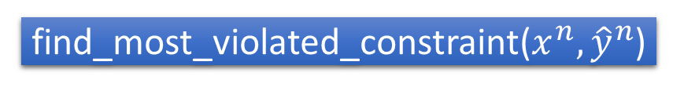
svm_python_learn
What you have to implement by yourself
$$\left\{\left(x^{1},{\hat{y}}^{1}\right),\left(x^{2},{\hat{y}}^{2}\right),⋯,\left(x^{N},{\hat{y}}^{N}\right)\right\}=$$
read_examples(TrainingData)
init_model()
w $←$0, working set $𝔸^{1}←null, 𝔸^{2}←null,⋯,𝔸^{N}←null$
Repeat
For each training data:
$${\overline{y}}^{n}=$$
find_most_violated_constraint($x^{n},{\hat{y}}^{n}$)
$$arg\max_{y}\left[∆\left({\hat{y}}^{n},y\right)+w∙φ\left(x^{n},y\right)\right]$$
Update working set$𝔸^{n}←𝔸^{n}∪\left\{{\overline{y}}^{n}\right\}$
$w←$Solve a QP with Working Set $𝔸^{1}, 𝔸^{2},⋯,𝔸^{N}$
Until the stopping criterion fulfilled
Return $w$

Slide 5


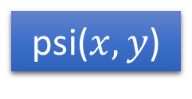
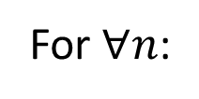
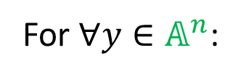
svm_python_learn - QP
$$\frac{1}{2}{\left\|w\right\|}^{2}+λ\sum_{n=1}^{N}{ε^{n}}$$
QP:
Find 𝑤, 𝜀¹…𝜀^{𝑁} minimizing
For $∀n$:
For $∀y∈𝔸^{n}$:
$$w∙\left(φ\left(x^{n},{\hat{y}}^{n}\right)−φ\left(x^{n},y\right)\right)≥∆\left({\hat{y}}^{n},y\right){−ε^{n}},ε^{n}≥0$$
psi($x,y$)
loss(${\hat{y}}^{n},y$)
Usage: ./svm_python_learn –c 1000 TrainingData Model
-e value (smaller, training time longer)
-k int (number of new constraints to accumulate before recomputing the QP)

Slide 6
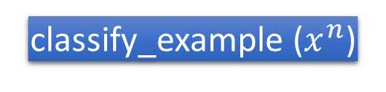


svm_python_classify
For each test data:
Inference
${\tilde{y}}^{′}←Inference\left(x^{′},w\right)$
classify_example ($x^{n}$)
$$arg\max_{y}{w∙φ\left(x^{n},y\right)}$$
Usage: ./svm_python_classify TestingData Model Result

Slide 7
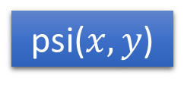
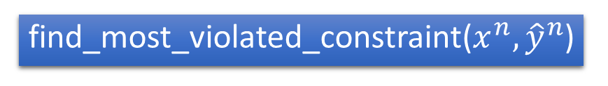
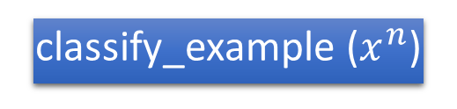
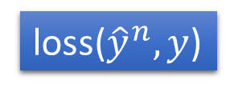
svmstruct.py
Put your code in svmstruct.py
read_examples(filename)
init_model()
find_most_violated_constraint($x^{n},{\hat{y}}^{n}$)
psi($x,y$)
loss(${\hat{y}}^{n},y$)
classify_example ($x^{n}$)
Using multi-class classification to show how to implement each function
http://tfinley.net/software/svmpython2/multiclass_code.html

Slide 8
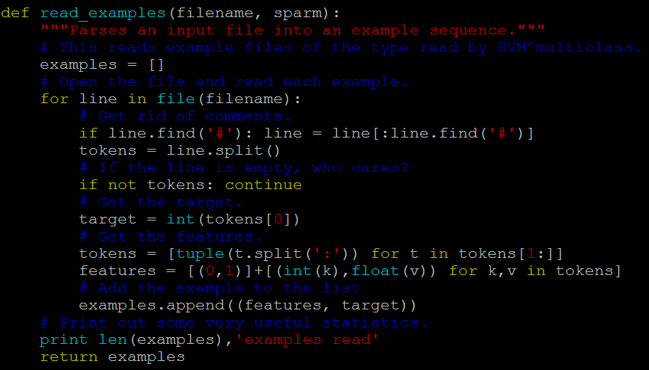

read_examples
$$\left\{\left(x^{1},{\hat{y}}^{1}\right),\left(x^{2},{\hat{y}}^{2}\right),⋯,\left(x^{N},{\hat{y}}^{N}\right)\right\}=$$
read_examples(TrainingData)

Slide 9
read_examples
Format of “examples” (training data)
The whole “examples” (training data) is a list
Each data is a tuple with two element
$$examples=[ \left(x^{1},{\hat{y}}^{1}\right),… \left(x^{n},{\hat{y}}^{n}\right),… \left(x^{N},{\hat{y}}^{N}\right) ]$$
Input object
output object
[
(3,6.55),
(7,-1.01),
…
(10,0.4)
]
Sparse representation
of a vector
a scalar

Slide 10
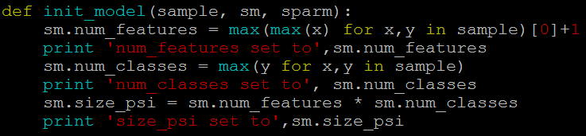
init_model
Tell SVM^{struct} the feature dimension of w
Model
feature dimension of w
e.g. K classes, feature representation of x is M dimensions
sm.size_psi = K * M

Slide 11
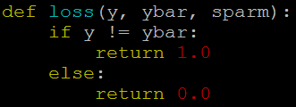

loss
$∆\left(\hat{y},y\right)$
Task dependent

Slide 12
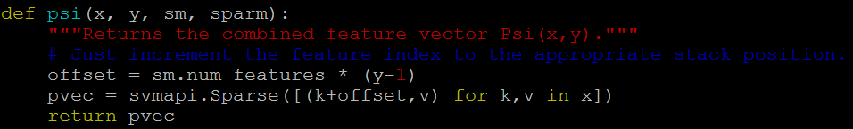





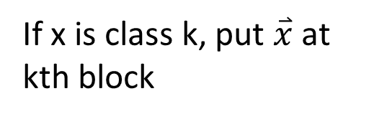

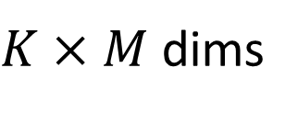
psi
$$0$$
K blocks
$$⋯$$
Each has M dimensions
$$φ\left(x,y\right)=$$
$$\overset{⃑}{x}$$
If x is class k, put $\overset{⃑}{x}$ at kth block
$K×M$ dims
$$⋯$$
$$0$$
0 for other dimensions
y = k (class k)
x:
[
(3,6.55),
(7,-1.01),
…
(10,0.4)
]
[
(3+(k-1)*M,6.55),
(7+(k-1)*M,-1.01),
…
(10+(k-1)*M,0.4)
]
vec = svmapi.Sparse( )
return vec

Slide 13
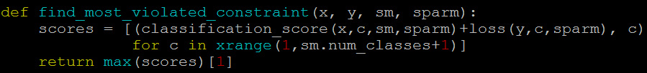

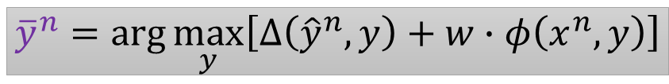
find_most_violated_constraint
$${\overline{y}}^{n}=arg\max_{y}\left[∆\left({\hat{y}}^{n},y\right)+w∙φ\left(x^{n},y\right)\right]$$
vec = psi(x,y)
w = sm.w
score = 0
$$w∙φ\left(x^{n},y\right)$$
for k, v in vec:
The value at k dimension is v.
score = score + v * w[k]

Slide 14
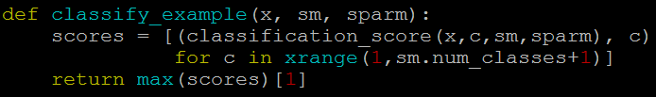
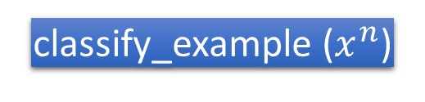

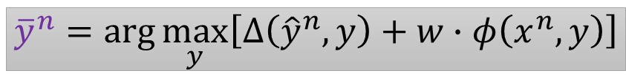

classify_example
For each test data:
Inference
${\tilde{y}}^{′}←Inference\left(x^{′},w\right)$
classify_example ($x^{n}$)
$$arg\max_{y}{w∙φ\left(x^{n},y\right)}$$
$${\overline{y}}^{n}=arg\max_{y}\left[∆\left({\hat{y}}^{n},y\right)+w∙φ\left(x^{n},y\right)\right]$$

